Slide 1
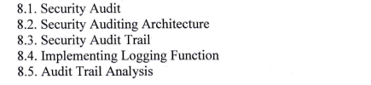
Chapter 8 : Security Auditing

Slide 2
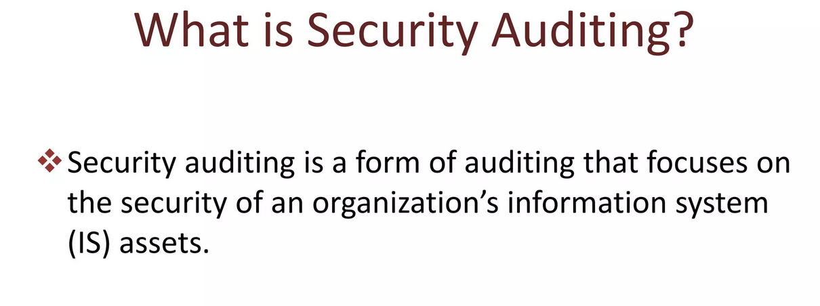

Slide 3
Common IT Security Audit Standards
ISO Compliance
HIPAA Security Rule
PCI DSS Compliance
SOX Compliance

Slide 4
ISO Compliance:
ISO (International Organization for Standardization) compliance refers to adherence to standards set by ISO, which covers a wide range of industries and processes.
One of the most well-known standards is ISO 27001, which specifies requirements for establishing, implementing, maintaining, and continually improving an information security management system (ISMS).

Slide 5
HIPAA Security Rule:
HIPAA (Health Insurance Portability and Accountability Act) is a U.S. law designed to provide privacy standards to protect patients' medical records and other health information.
The HIPAA Security Rule specifically focuses on protecting electronic personal health information (e-PHI) that is created, received, used, or maintained by a covered entity. It requires appropriate administrative, physical, and technical safeguards to ensure the confidentiality, integrity, and security of e-PHI.

Slide 6
PCI DSS Compliance:
PCI DSS (Payment Card Industry Data Security Standard) is a set of security standards designed to ensure that all companies that accept, process, store, or transmit credit card information maintain a secure environment.
It is a requirement for any organization that handles cardholder data, and it covers various aspects of security, including network security, access control, and monitoring and testing of networks.

Slide 7
SOX Compliance:
SOX (Sarbanes-Oxley Act) is a U.S. law enacted in 2002 to protect investors from fraudulent financial reporting by corporations.
SOX compliance involves strict requirements for financial reporting and internal controls, including the accuracy of corporate disclosures and the prevention of accounting fraud.

Slide 8
Security Audit Best Practices
Get Back to Basic
Practice Preparedness
Make it a team effort

Slide 9
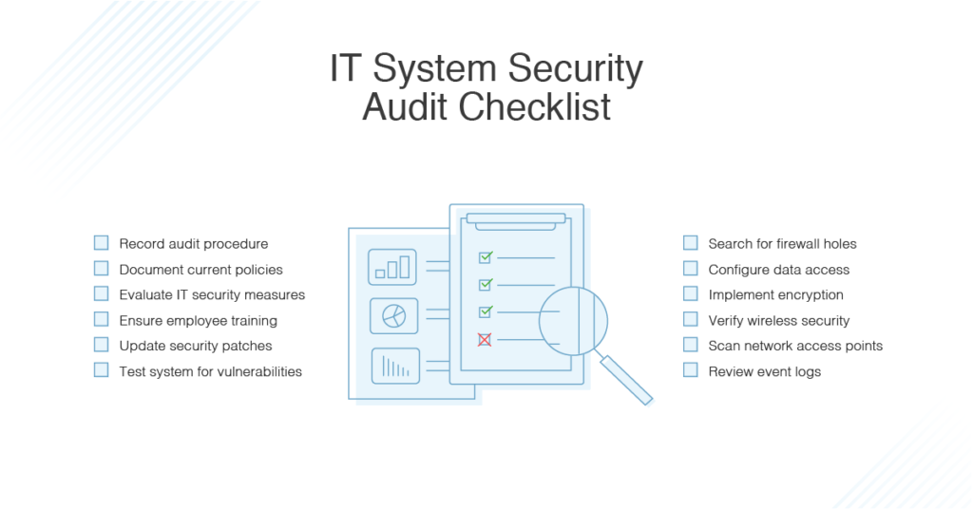

Slide 10
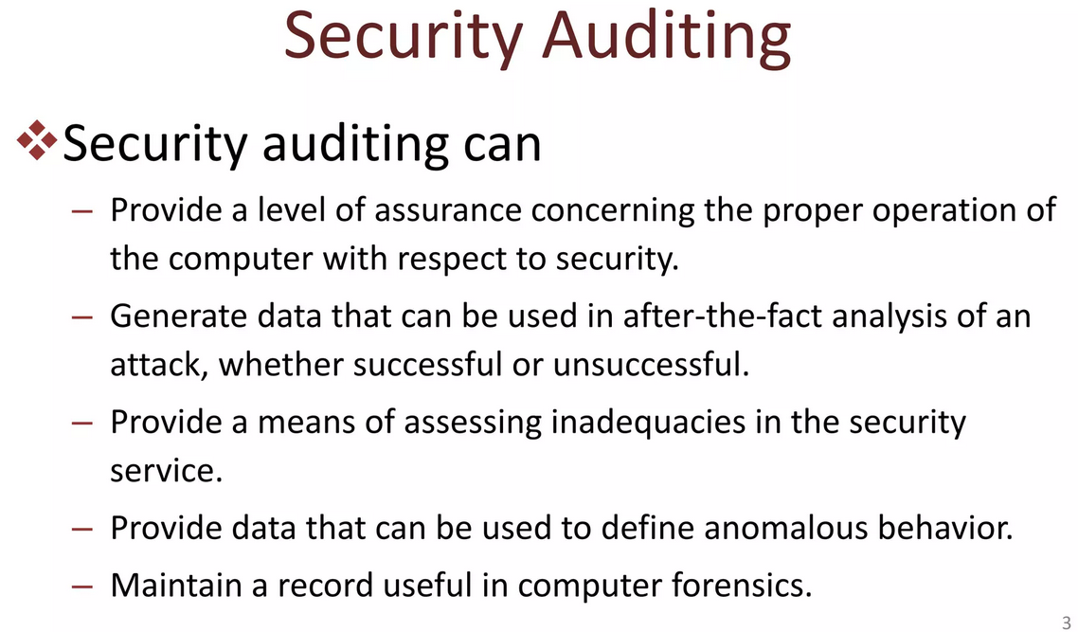

Slide 11
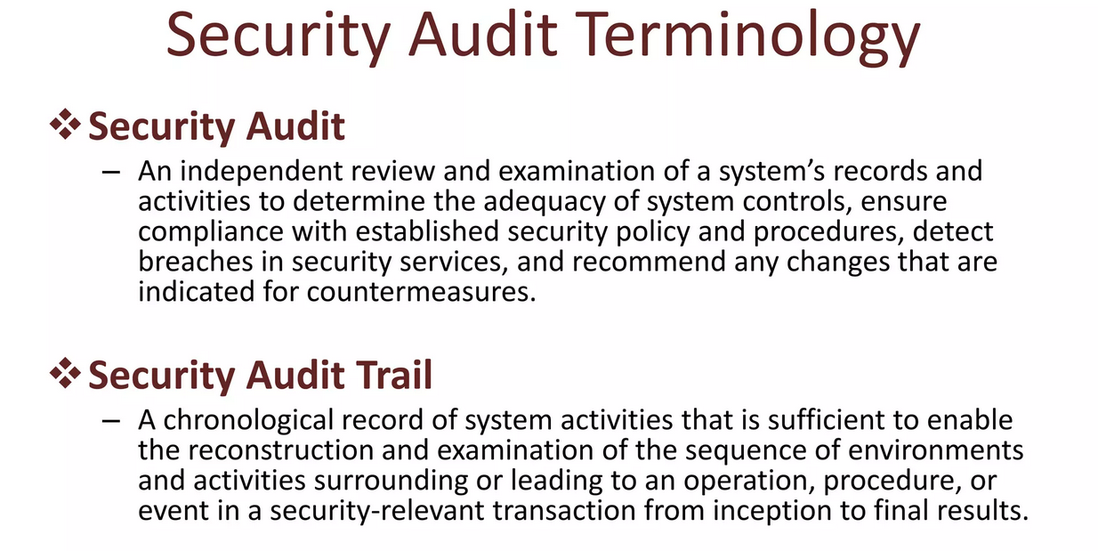

Slide 12
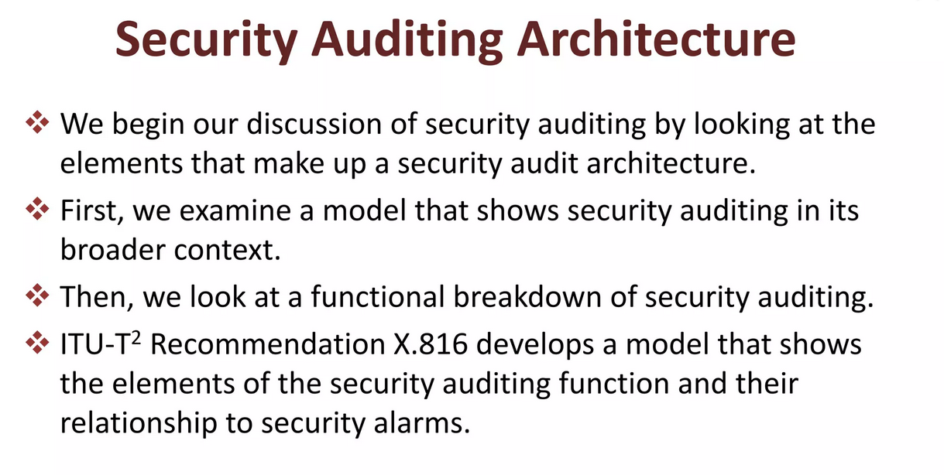

Slide 13
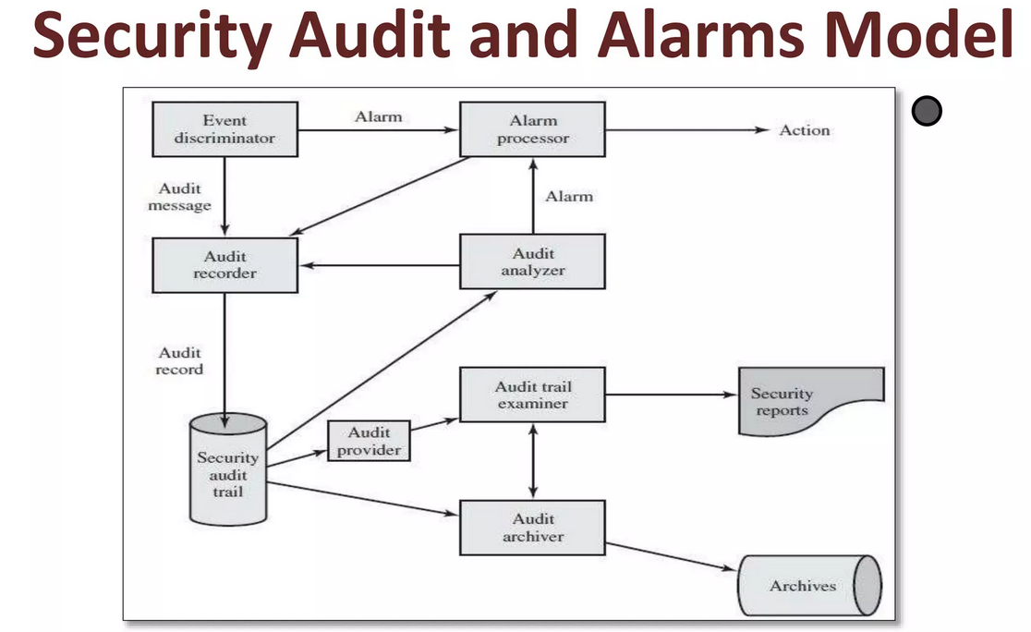

Slide 14
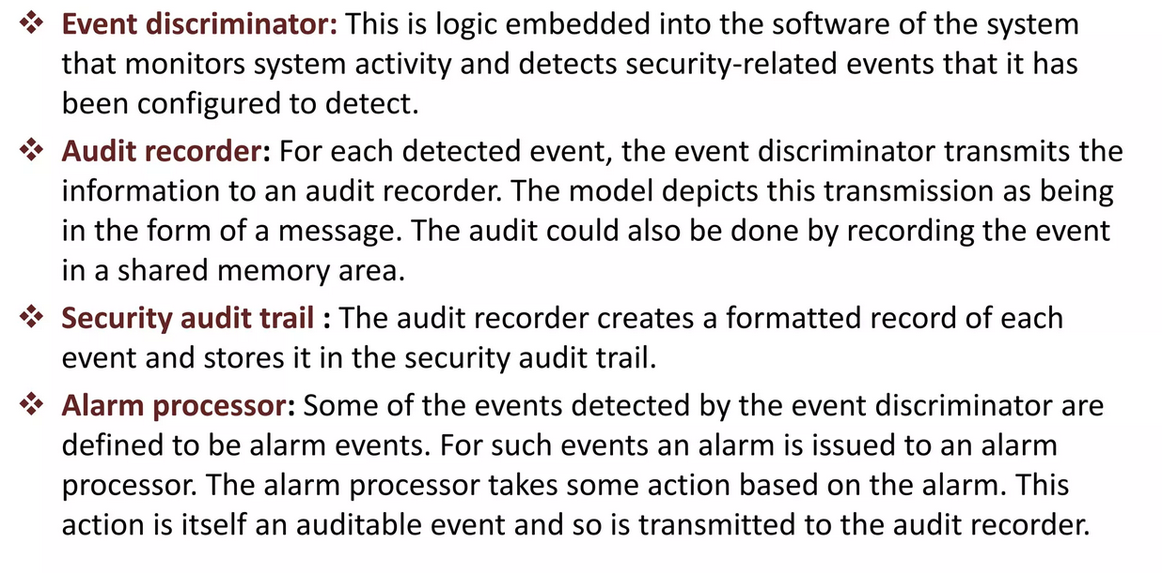

Slide 15
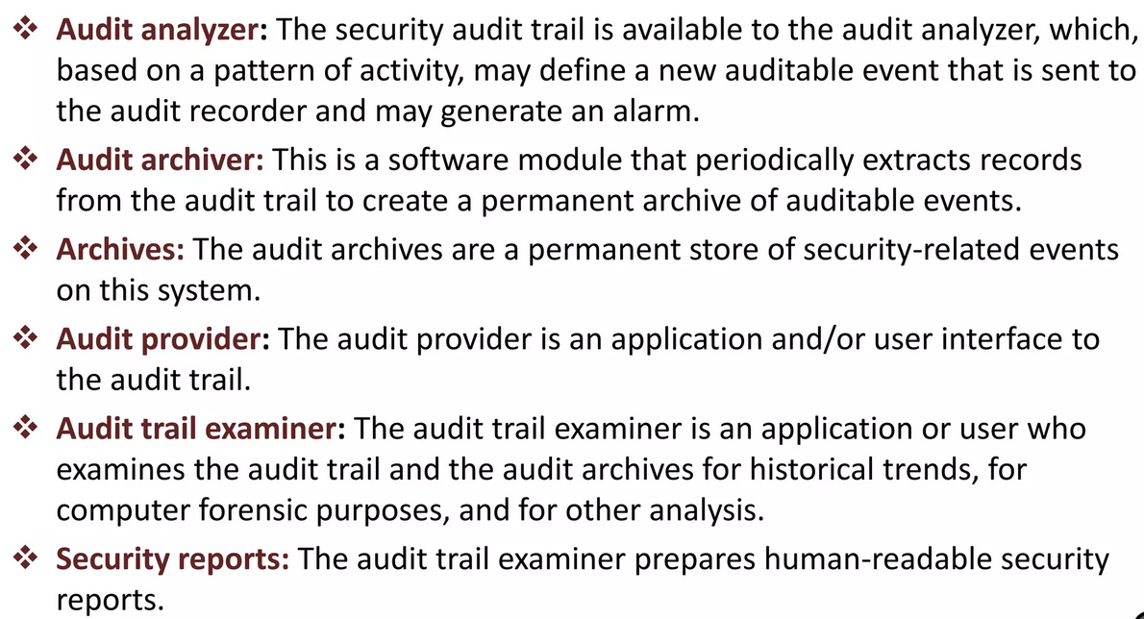

Slide 16
Implementing Logging Function
Auditing records should, at a minimum, detail the unique user ID, unique data subject ID, function performed, type of event, the date and time of an event, the possible identity of the subject of the event, and the information that may have been affected by the event.
Logging activity should capture the creation, review, modification, or deletion of identified information.
The success/failure of the event, the account involved, and the processes involved should be tracked as part of the audit record for privileged users.

Slide 17
The activities of privileged users (administrators, operators, etc.) include the success/failure of the event, time the event occurred, the account involved, the processes involved, and additional information about the event.
Proper logging should be enabled in order to audit administrator activities; and reviews system administrator and operator logs on a regular basis.

Slide 18
How often security logs be reviewed?
Security logs should be reviewed regularly depending on your security objectives and compliance requirements.
Audit logs should be maintained for management activities, system and application startup/shutdown/errors, file changes, and security policy changes.
An intrusion detection system should be managed outside of the control of system and network administrators used to monitor system and network administration activities for compliance.

Slide 19
Purpose of an Audit Trail (logs)
The purpose of auditing and logging is to record and examine activity in information systems that affect information assets.
This includes any hardware, software, or procedural controls in place to track such activity as modifying information assets including protected health information within information systems.

Slide 20
Why is an Audit Trail Important?
Based on the risk assessment and other business needs, security auditing and event logging of information systems should be supported by input from different departments across the entire organization.
Among these are failed logins, multiple system authentication, and suspicious after-hours login behavior, to name a few.
Documentation should be kept as to the rationale behind the list of events chosen to adequately support an investigation of a breach or incident.

Slide 21
How Do You Maintain the Audit Trail?
In software, an audit trail documents each user’s activity, including changes and approvals, timestamp of dates and times, IP addresses, and user logins. Record retention periods for audit trail logs will depend on government and industry regulations applicable to your business activities. Establish a company policy that’s approved by the Board of Directors.

